Slide 1

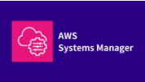

AWS Systems Manager
Parameter Store
Secure Configuration and Secrets Management
Presenter: Vignesh Adlagatta
AWS Cloud Operations & Security Module

Slide 2





SESSION AGENDA
Core Concepts
Security & Auth
Implementation
Intro to Systems Manager, Parameter Store roles, and features.
KMS Encryption, IAM integration, and SecureString handling.
CLI operations, Hierarchy, Versioning, and Best Practices.

Slide 3

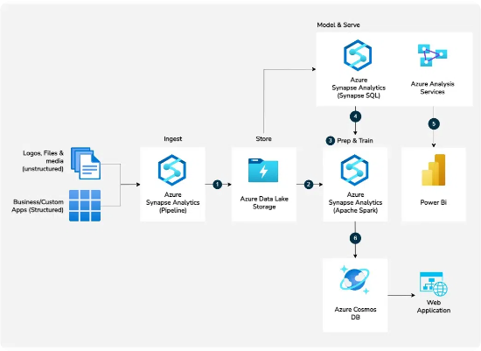
AWS SYSTEMS MANAGER (SSM)
Centralized Operations
AWS Systems Manager is a hub for managing AWS resources centrally across infrastructure.
Operational management for Hybrid Cloud.
Automated software inventory and patching.
Unified view of operational data.
Resource grouping and configuration.

Slide 4


WHAT IS PARAMETER STORE?
Configuration Management
A capability of AWS Systems Manager that provides secure, hierarchical storage for configuration data and secrets management.
Stores DB strings, passwords, and license codes.
Separates configuration from application code.
Supports both plain text and encrypted data.
Centralized control for DevOps workflows.

Slide 5
WHY USE PARAMETER STORE?
Eliminate Hardcoding: Move sensitive data out of source code and configuration files.
Granular Access: Use IAM policies to control who can view or modify specific parameters.
Encryption at Rest: Automatically encrypt sensitive strings using AWS KMS.
Auditability: Track changes and access logs via CloudTrail and CloudWatch.

Slide 6



KEY CAPABILITIES
Hierarchy
Versioning
KMS Support
Organize parameters in tree structures like /prod/db/pass.
Automatic versioning on every update for easy rollbacks.
Native integration with Key Management Service for SecureStrings.

Slide 7
PARAMETER STORE VS SECRETS MANAGER
Feature | Parameter Store | Secrets Manager
Primary Purpose | General config and simple secrets | Complex secrets with lifecycle management
Cost | Free tier available (Standard) | Paid per secret, per month
Rotation | Manual or via custom Lambda | Native, built-in Lambda rotation
Rotation Trigger | N/A | Direct RDS integration

Slide 8



PARAMETER DATA TYPES
String
StringList
SecureString
Simple text values like environment names or URLs. "production"
Comma-separated arrays of values. "us-east-1,us-west-2"
Encrypted sensitive data using KMS keys. "Encrypted_Payload"

Slide 9
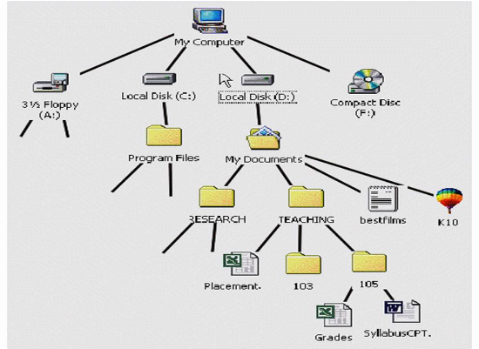

ORGANIZING WITH HIERARCHIES
Hierarchies help manage parameters by environment or application component.
/prod/db/endpoint
/prod/db/password
/dev/api/key
/global/region

Slide 10
AUTOMATIC VERSIONING
Parameter Store tracks every change. Every time you "PutParameter" with the same name, the version increments.
V4
Immutable history of values.
Access specific versions via ARN.
Current Active Version
Audit who changed what and when.
Revert to older versions if current one breaks.

Slide 11


PARAMETER POLICIES
Expiration
Notifications
Automatically delete a parameter at a specified time or date.
Receive CloudWatch Events when a parameter is about to expire or has changed.

Slide 12

THE SECURITY MODEL
Defense in Depth
Security is managed through two primary mechanisms:
IAM Roles/Policies: Controls "Who" can access specific paths.
AWS KMS: Controls the encryption/decryption of the content.

Slide 13

AWS KMS ENCRYPTION
When using SecureString, the SSM service calls KMS to encrypt your data before storage. Upon retrieval, if --with-decryption is passed, SSM uses KMS to return plaintext to authorized users.

Slide 14


ARCHITECTURE COMPONENTS
Application
SSM API
AWS KMS
The consumer requesting config (EC2, Lambda, ECS).
The service endpoint handling requests.
Provider of cryptographic operations.

Slide 15
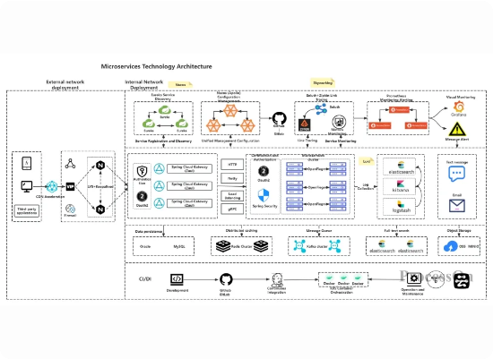
ARCHITECTURE WORKFLOW
1. Request: App requests /db/pass.
2. Auth: IAM verifies if the App Role has ssm:GetParameter.
3. Decrypt: SSM requests KMS to decrypt using kms:Decrypt.
4. Response: SSM returns Plaintext to the Application.

Slide 16
CREATING VIA AWS CONSOLE
Navigate to Systems Manager > Parameter Store.
Click Create parameter.
Enter a Name (e.g., /prod/app/db-url).
Select Type (String, StringList, or SecureString).
For SecureString, choose your KMS Key (default or custom).
Enter the Value and click Create.

Slide 17
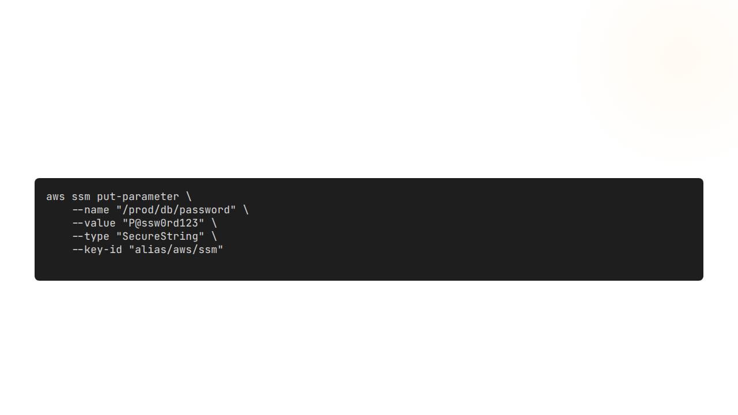

CREATING VIA AWS CLI
Creates an encrypted parameter using the default SSM service key.

Slide 18
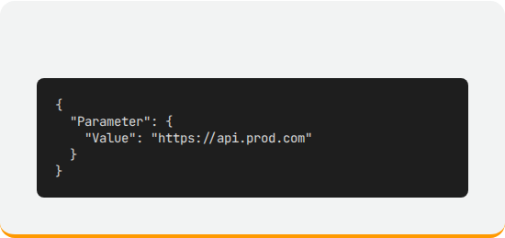
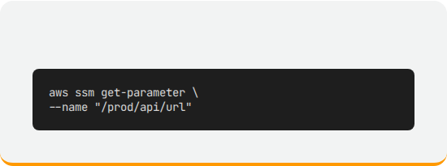
RETRIEVING VIA AWS CLI
Output Preview
Standard Get

Slide 19
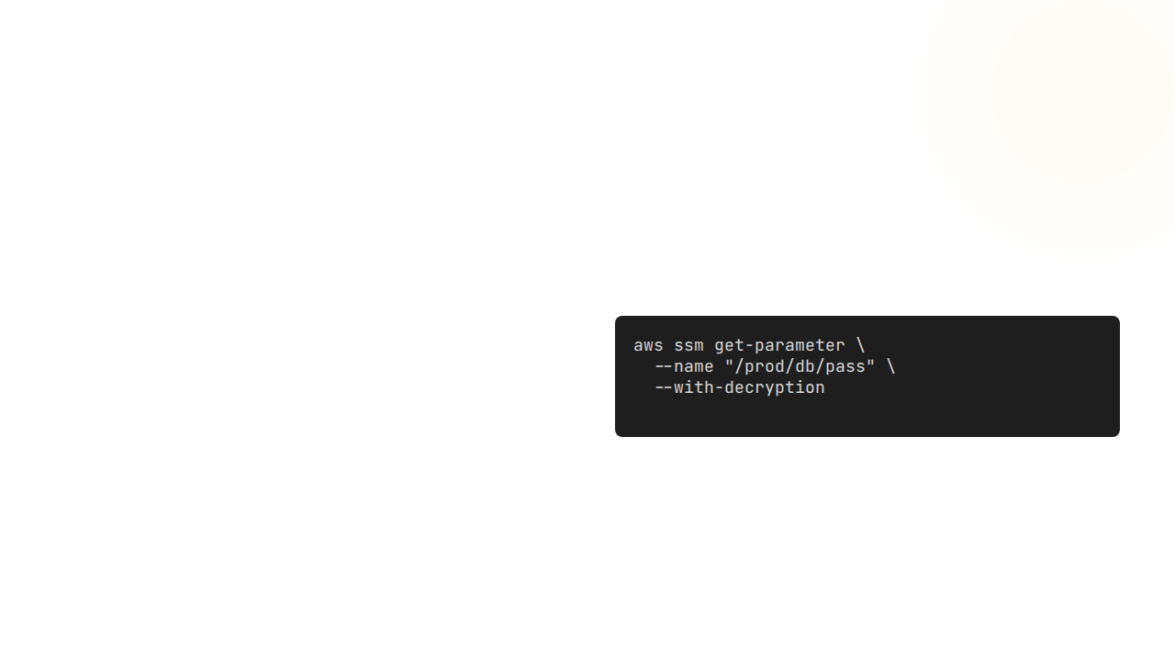
RETRIEVING SECURE PARAMETERS
The Decryption Flag
By default, get-parameter returns the encrypted cipher text for SecureString.
You MUST use the --with-decryption parameter to get the actual secret.

Slide 20

USING WITH AMAZON EC2
Instance Profile Access
EC2 instances retrieve configuration at runtime or during boot-strapping (User Data).
Assign an IAM Role to the EC2 instance.
Grant permission for ssm:GetParameters on specific paths.
Applications use AWS SDK (Boto3, JS SDK) to fetch values.

Slide 21


USING WITH AWS LAMBDA
Serverless Configuration
Lambda functions can pull secrets without exposing them in environment variables.
Fetch parameters inside the handler code.
Cache values outside the handler for performance.
Secure execution environment ensures zero exposure.

Slide 22

CONTAINER INTEGRATION (ECS)
AWS ECS allows passing SSM parameters directly into container definitions as environment variables.
The ECS agent handles the retrieval and decryption, injecting the final value into the container's ENV space at runtime.

Slide 23
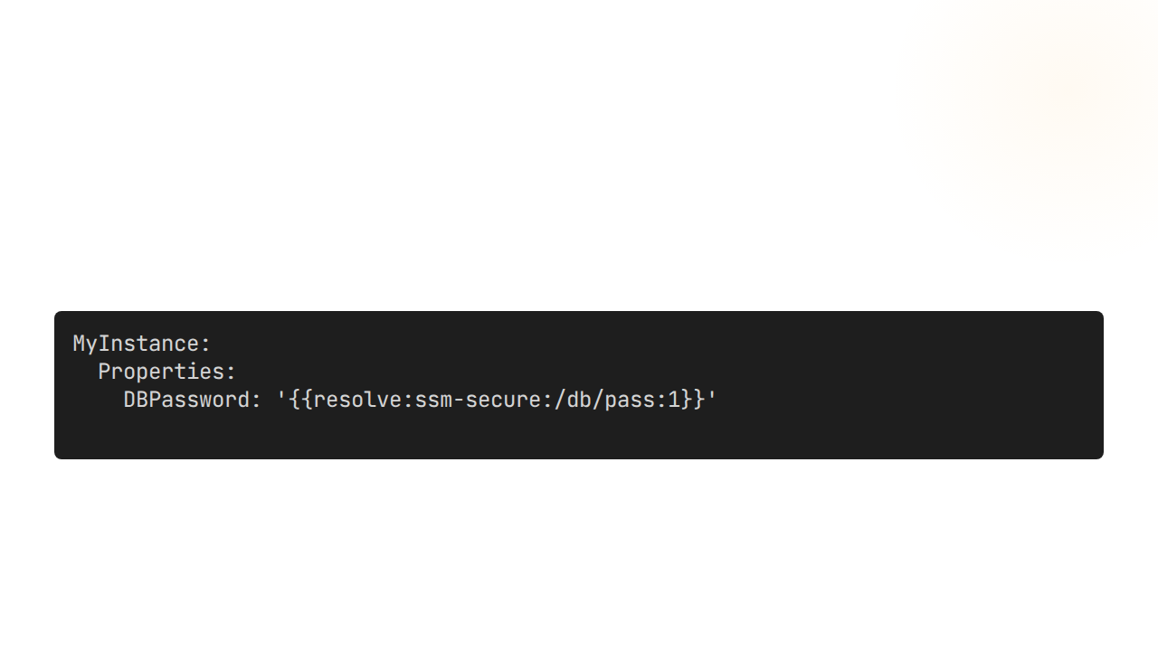
CLOUDFORMATION DYNAMIC REFS
Fetch values directly in your infrastructure code using dynamic references.
Automatically pulls Version 1 of the secure parameter during stack deployment.

Slide 24





CI/CD WITH CODEPIPELINE
Secure Build
Deploy Secrets
Rotation Sync
Inject API keys into CodeBuild projects without committing them to Git.
Pass deployment credentials to staging or production targets securely.
Always pull the latest version during the pipeline execution.

Slide 25

LAMBDA ENV VARIABLE INJECTION
Configuration Mapping
Instead of hardcoding, map Environment Variables to SSM ARNs.
Centralizes Lambda configuration.
Update one parameter to affect multiple functions.
Securely handles sensitive runtime data.

Slide 26
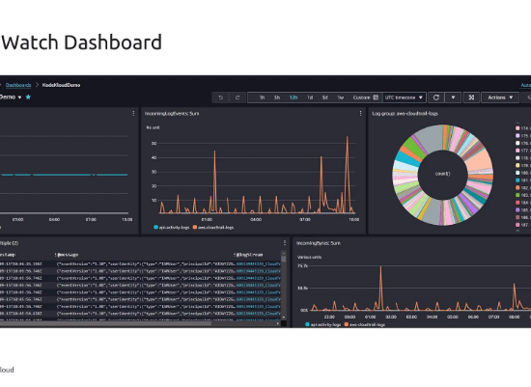
CLOUDWATCH MONITORING
Usage Analytics
Track throughput and error rates for your Parameter Store requests.
Monitor ThrottlingExceptions.
Alarms for parameter expiration.
Visualize usage trends over time.

Slide 27
AUDITING WITH CLOUDTRAIL
Event Name | Action Tracked | User / Identity
PutParameter | Creation or Update | Admin / Automation
GetParameter | Read access | Application Role
DeleteParameter | Removal of data | IAM Principal
Essential for compliance and identifying security breaches.

Slide 28
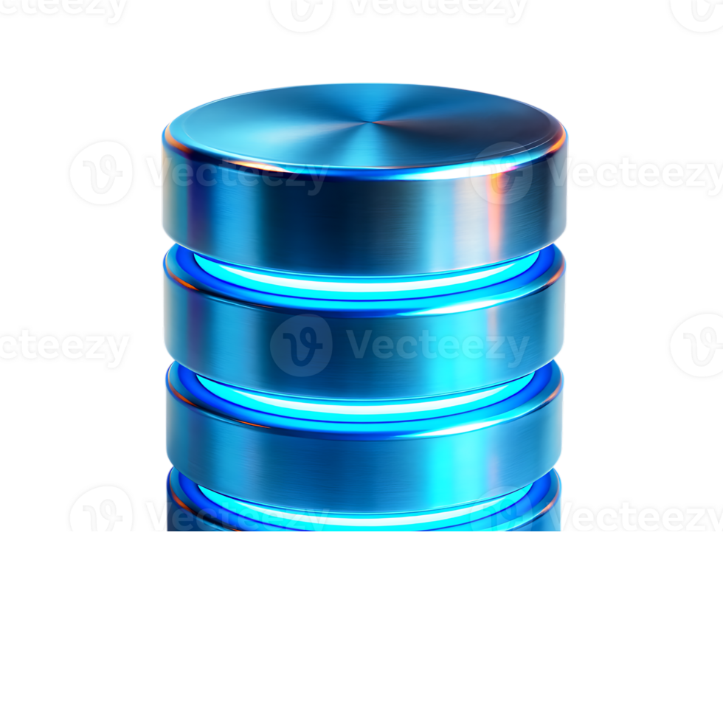
USE CASE: DB CREDENTIALS
Problem: Credential Leaks
Storing database passwords in web.config or application.properties files is a major security risk.
Solution
Application fetches credentials from /prod/app/db/password at startup. IAM ensures only the App server can see this value.

Slide 29
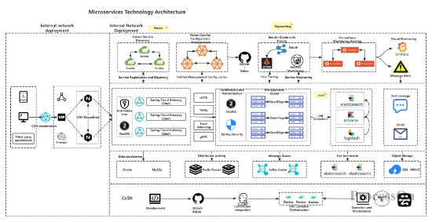
USE CASE: MICROSERVICES
Global Configuration Store
Manage shared settings across dozens of services.
Shared API endpoints.
Feature flags (On/Off).
Logging levels per service.
Centralized updates without redeploying code.

Slide 30
USE CASE: SERVERLESS SECRETS
Lambda functions integrated with third-party APIs (Stripe, Twilio, SendGrid).
Store API keys as SecureString.
Rotate keys centrally in SSM.
No plain text exposure in Lambda Console.

Slide 31
BEST PRACTICES
Always Use SecureString: For any sensitive data like passwords or tokens.
Path-Based IAM: Use wildcards like arn:aws:ssm:*:*:parameter/prod/* to limit scope.
Enable Policies: Set expiration for temporary credentials.
KMS Custom Keys: Use custom CMKs instead of default keys for better auditing.

Slide 32
COMMON IMPLEMENTATION MISTAKES
Hardcoding Values
Broad IAM Permissions
Leaving parameters in code because "it's easier for development".
Giving ssm:* or ssm:GetParameters on * resources.

Slide 33



SUMMARY OF ADVANTAGES
Scalability
Cost Efficiency
Deep Integration
Handles thousands of requests per second with high availability.
Standard tier is free of charge for storage and throughput.
Works natively with almost every AWS service.

Slide 34
CURRENT LIMITATIONS
No Auto-Rotation: Unlike Secrets Manager, you must build custom rotation logic.
Size Limits: 4KB limit for Standard tier (8KB for Advanced).
Parameter Limits: Standard is limited to 10,000 parameters per region.
Throughput: Standard throughput is 40 TPS (can be increased).

Slide 35
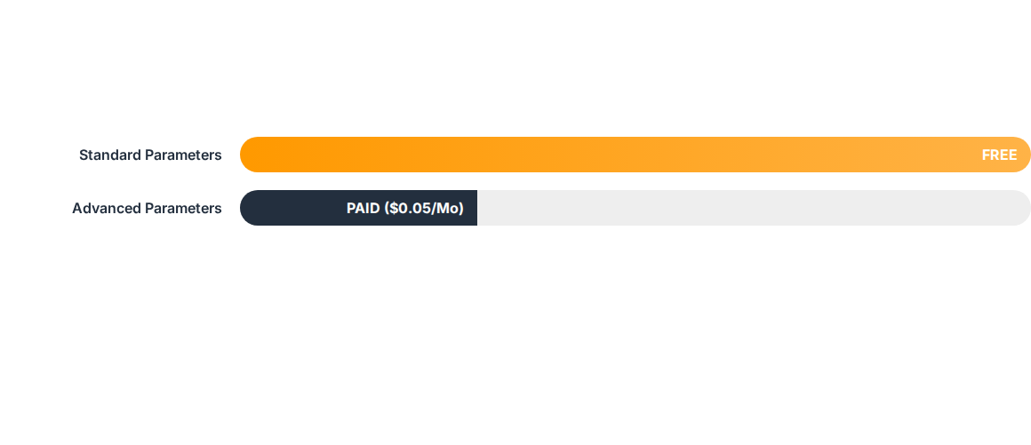
TIER COMPARISON & COST
*Advanced tier supports larger parameter sizes and policies like expiration.

Slide 36




STANDARD DEMO WORKFLOW
Get
Put
KMS
Store
Decrypt -> App
Value -> SSM
Encrypt
Cipher Text

Slide 37


COURSE SUMMARY
The "What"
The "How"
The "Best"
Centralized secure storage for config and secrets.
IAM for access, KMS for encryption, Console/CLI for ops.
Use hierarchies, SecureStrings, and monitor with Trail.

Slide 38
THE FUTURE: CLOUD OPS
Infrastructure as Code
As organizations move toward 100% automation, Parameter Store remains the bedrock of secure configuration injection.
Dynamic CI/CD pipelines.
Zero-trust architecture.
AI-driven secrets monitoring.

Slide 39
TOP INTERVIEW QUESTIONS
Q: What is the difference between PS and Secrets Manager?
Q: How do you retrieve an encrypted parameter in CLI?
Q: Can Parameter Store trigger a Lambda function on change?
Q: What is a parameter hierarchy and why is it useful?

Slide 40

Thank You!
Questions or Feedback?
Presenter: Vignesh Adlagatta
AWS Certified Solution Architect

Slide 41






IMAGE SOURCES
https://neenet-pro.com/wp-content/uploads/2024/03/eyecatch_ssm.jpg
Source: neenet-pro.com
https://media.geeksforgeeks.org/wp-content/uploads/20241004135011343786/Azure-Architecture.webp
Source: www.geeksforgeeks.org
https://static.vecteezy.com/system/resources/previews/027/899/606/non_2x/lock-cyber-security-padlock-with-keyhole-icon-in-hand-protect-and-security-or-safe-concept-illustrates-cyber-data-security-or-information-privacy-idea-low-polygonal-illustration-vector.jpg
Source: www.vecteezy.com
https://informationtechnologyja.wordpress.com/wp-content/uploads/2019/09/presentation4.jpg?w=1000
Source: informationtechnologyja.wordpress.com
https://res.cloudinary.com/hy4kyit2a/f_auto,fl_lossy,q_70/learn/modules/aws-cloud-security/learn-about-aws-security-services/images/ced63f73b4f9fcd8e2434677b0b995bb_fa-00-ef-19-7-e-4-b-4739-a-1-f-7-3-f-0-a-2-f-9734-c-7.png
Source: trailhead.salesforce.com
https://cdn.processon.io/admin/knowledge/article_content_img/67b6a344bcb4581cedd12229.png
Source: www.processon.io

Slide 42






IMAGE SOURCES
https://miro.medium.com/1*UfkVdTaCy-ArRy3QgoZcbA.png
Source: medium.com
https://upload.wikimedia.org/wikipedia/commons/5/5c/Amazon_Lambda_architecture_logo.svg
Source: en.wikipedia.org
https://miro.medium.com/1*7kVuA15vB-r7tatWhB_UeA.png
Source: aws.plainenglish.io
https://kodekloud.com/kk-media/image/upload/v1752859845/notes-assets/images/AWS-Certified-SysOps-Administrator-Associate-Building-Cloudwatch-Dashboards-for-Visualization/cloudwatch-dashboard-metrics-graphs.jpg
Source: notes.kodekloud.com
https://static.vecteezy.com/system/resources/previews/070/913/731/non_2x/blue-metal-database-server-icon-isolated-on-transparent-background-png.png
Source: www.vecteezy.com
https://slidechef.net/wp-content/uploads/2024/03/business-thank-you-slides.jpg
Source: slidechef.net

